Slide 1
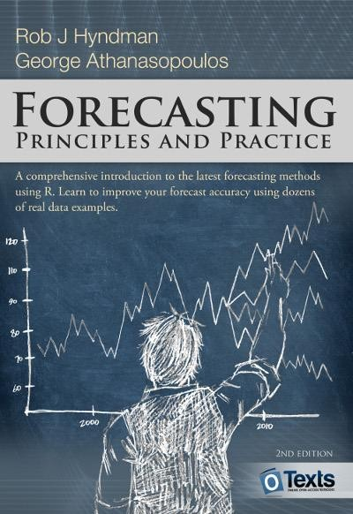
DSB24018 Applied Forecasting
Chapter 7 Exponential Smoothing
M.Sc. & MBA. Cuong Chi Nguyen
Based on work of Dr. Liang (Leon) Chen
PhD. In Decision Science & Information Systems
University of Kentucky
1

Slide 2
Chapter 7 Learning Objectives
Understand and apply various exponential smoothing methods for forecasting
Understand Simple exponential smoothing and its two forms
Understand and perform Trend methods, including Holt’s linear trend method and Damped trend methods.
Understand and perform Holt-Winters’ seasonal method, either additive or
multiplicative.
Understand the taxonomy of exponential smoothing methods and state space models.
Perform the estimation and selection of ETS models using the ets function in R
Forecast with ETS models using the forecasting function in R
2

Slide 3

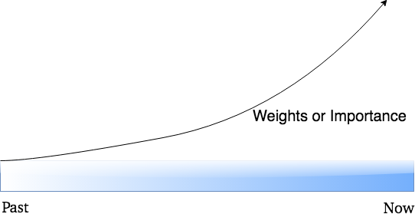
Exponential Smoothing
Proposed in the late 1950s (Brown, 1959; Holt, 1957;
Winters,1960)
Weighted averages of past observations, with the weights decaying exponentially as the observations get older: give higher weight to the more recent data
Generate reliable forecasts quickly and for a wide range of time series
Two parts in this Chapter
Chapters 7.1-7.4: present the mechanics of the most important exponential smoothing methods, and their application in forecasting time series with various characteristics
Chapters 7.5-7.7: present the statistical models that underlie exponential smoothing methods. These models generate identical
point forecasts to the methods discussed in the first part of the chapter, but also generate prediction intervals.
Past Observations
Recent Observations
3

Slide 4
7.1 Simple Exponential Smoothing (SES)
Suitable for forecasting data with no clear trend or seasonal pattern.
Weighted Average
Naïve method: the most recent observation is the only important one, and all previous observations provide no information for the future.
Average method: all observations are of equal importance, and gives them equal weights when generating forecasts.
Something Between: attach larger weights to more recent observations than to observations from the distant past.
Exponential Smoothing
Weights decrease exponentially as observations come from further in the past — the smallest weights are associated with the oldest observations.
The one-step-ahead forecast
4

Slide 5
7.1 SES: The Weights Attached to Observations
The higher α, the more quickly the weights decrease as observations come from further in the past and the more weight is given to the more recent observations.
The sum of the weights even for a small value of α will be approximately one for any reasonable sample size
1
The Weights Attached to Observations for Different α
0.8
α=0.9
α=0.8
0.6
α=0.6
0.4
α=0.4
α=0.2
0.2
α=0.1
0
t-1
t-2
t-3
t-4
t-5
t-6
t-7
t-8
5

Slide 6
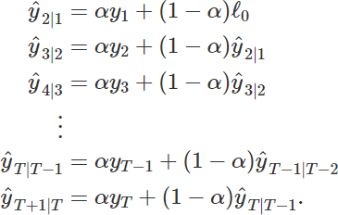
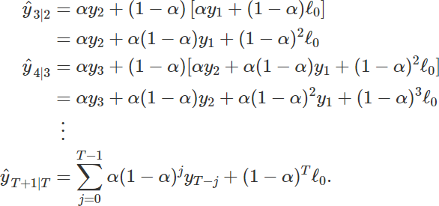

7.1 SES: Two Equivalent Forms
Weighted average form
The process has to start somewhere, so let the first fitted value at time 1 be denoted by ℓ₀, which we will have to estimate
Substituting each equation into its following equation
Become tiny (almost equal to zero) when T is getting large enough
Component form
Include a forecast equation and a smoothing equation for each of the components
Can recover the weighted average form of simple exponential smoothing.
The component form of simple exponential smoothing is not particularly useful, but it will be the easiest form to use when we start adding other components
6

Slide 7
7.1 SES: Others
Flat forecasts
All forecasts take the same value, equal to the last level component. Remember that these forecasts will only be suitable if the time series has no trend or seasonal component
Optimization
The application of every exponential smoothing method requires the smoothing parameters (α) and the initial values (ℓ₀)to be chosen.
Multiple combinations of α and ℓ₀
Like regression models, the unknown parameters and the initial values for any exponential smoothing method can be estimated by minimizing the SSE
Involves a non-linear minimization problem, and we need to use an optimization tool to solve it.
7

Slide 8
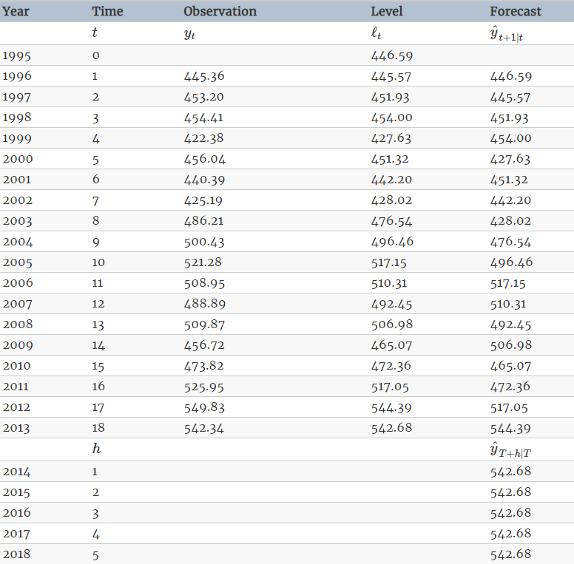
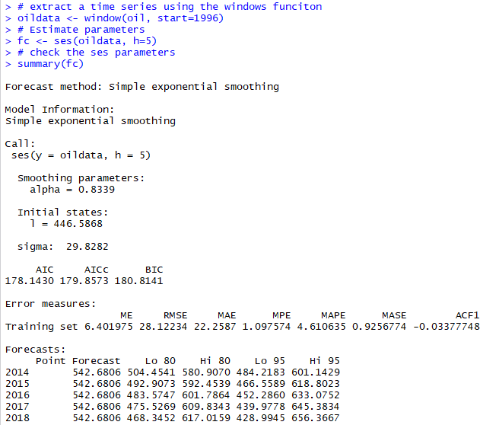
7.1 SES: Example
The standard deviation of residuals, ignore
it at this stage
8

Slide 9

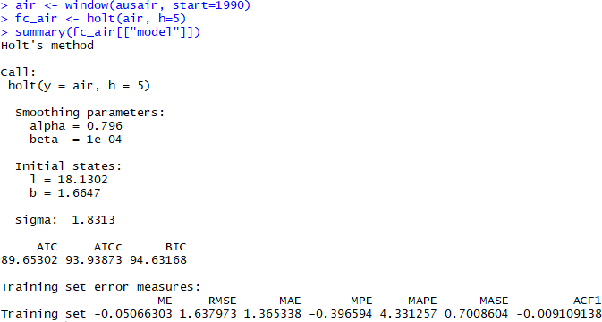
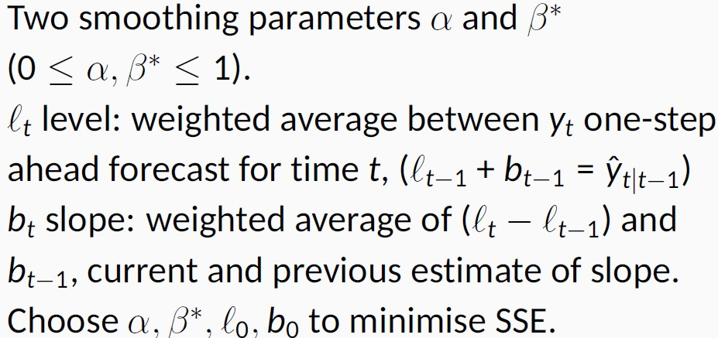
7.2 Trend Methods: Holt’s Linear Trend Method
Holt (1957) extended simple exponential smoothing to allow the forecasting of data with a trend.
The forecast function is no longer flat but trending
Equations
Example
Use this command to show the model only; if you use summary(fc_air), you can get the model and forecasts.
The very small value of β∗ means that the slope hardly changes over time.
The positive value of b means a positive
trend.
9

Slide 10

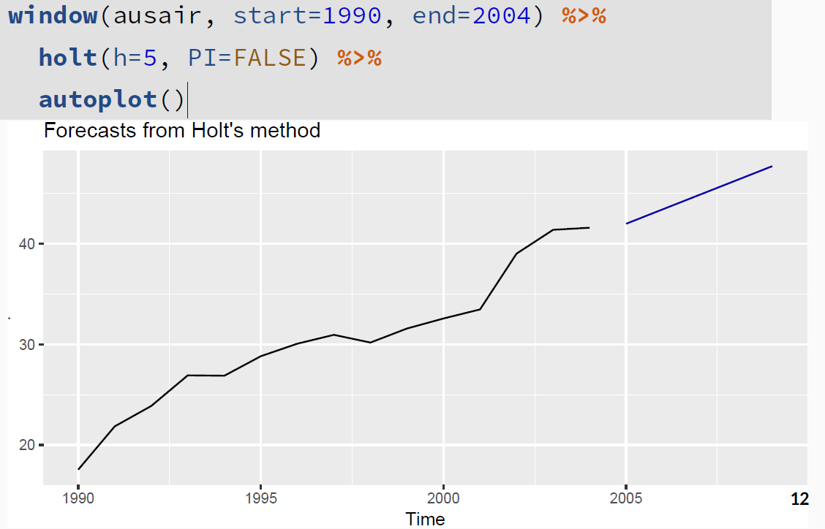
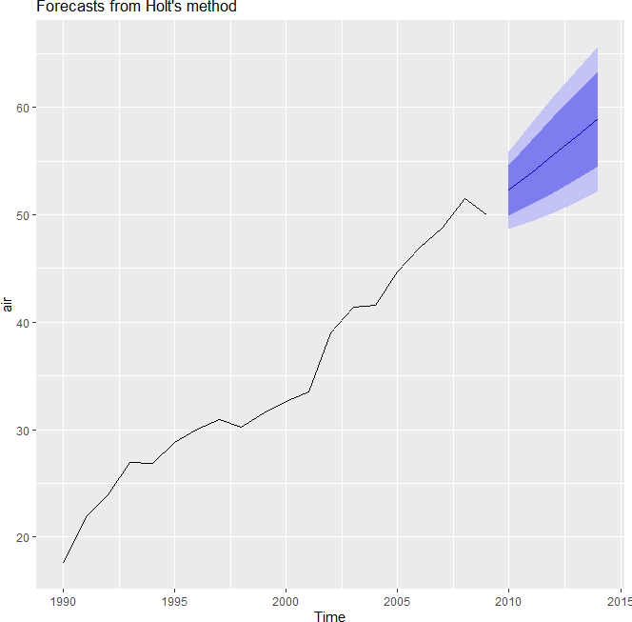
7.2 Trend Methods: Holt’s Linear Trend Method
With Prediction Interval
Without Prediction Interval
10

Slide 11



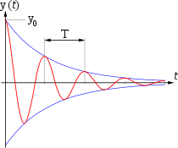
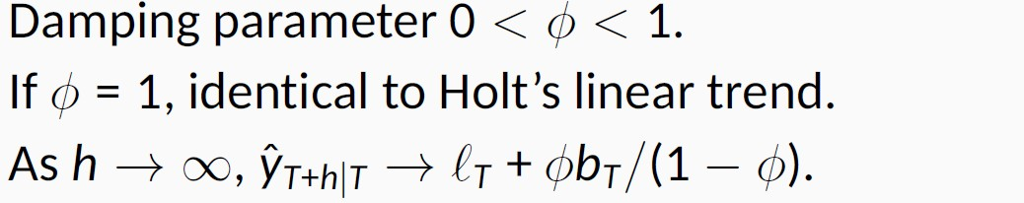

7.2 Trend Methods: Damped Trend Method
Problems with Holt’s linear method
Display a constant trend (increasing or decreasing) indefinitely into the future
Tend to over-forecast (i.e., forecast are consistently too high) especially for longer forecast horizons (when h is getting bigger, is getting greater too, so the it is over-forecasted).
Damped Trend
Proposed by Gardner & McKenzie (1985)
Introduce a parameter that “dampens” the trend to a flat line some time in the future
Proven to be very successful
Arguably the most popular individual methods when forecasts are required automatically for many series
Because ϕ(1+ ϕ+ ϕ²+ ϕ³+ ϕ⁴+…. = ϕ /(1- ϕ), a constant value

Slide 12
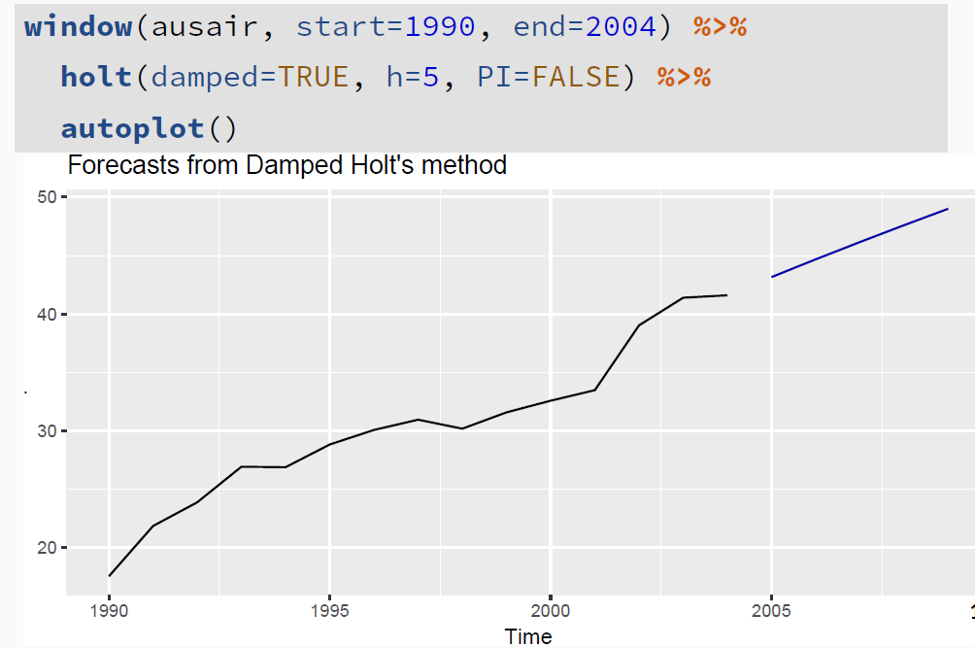
7.2 Trend Methods: Damped Trend Method Example
Still use the holt function, but make damped = True or T, and then R will find the optimized ϕ
You can also specify the ϕ value. For example:
The selection of ϕ
In practice, ϕ is rarely less than 0.8 as the damping has a very strong effect for smaller values.
Values of ϕ close to 1 will mean that a damped model is not able to be distinguished from a non-damped model.
For these reasons, we usually restrict ϕ to a
minimum of 0.8 and a maximum of 0.98.

Slide 13
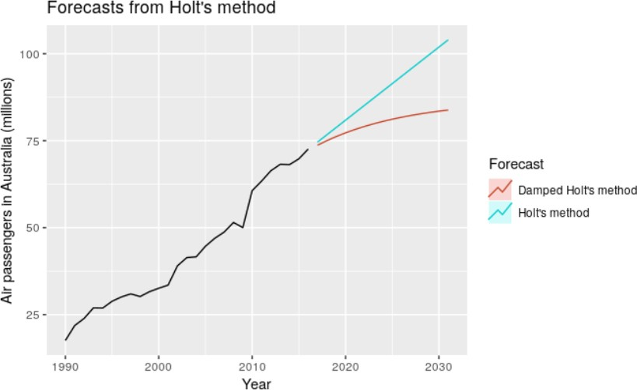
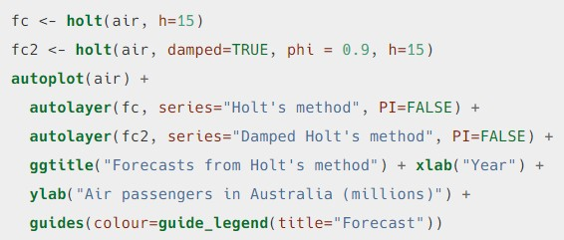
7.2 Trend Methods: Comparison
The trend is being damped, and will be emerge to a constant value when h is large enough; in contrast, Holt’s method will over forecast

Slide 14
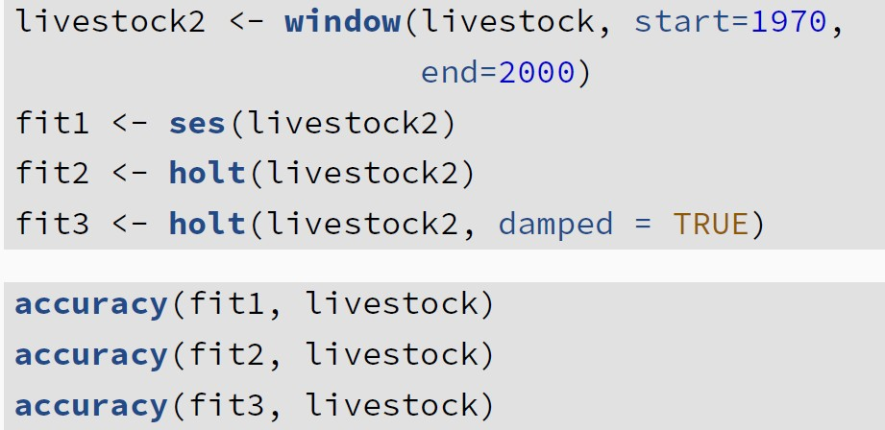
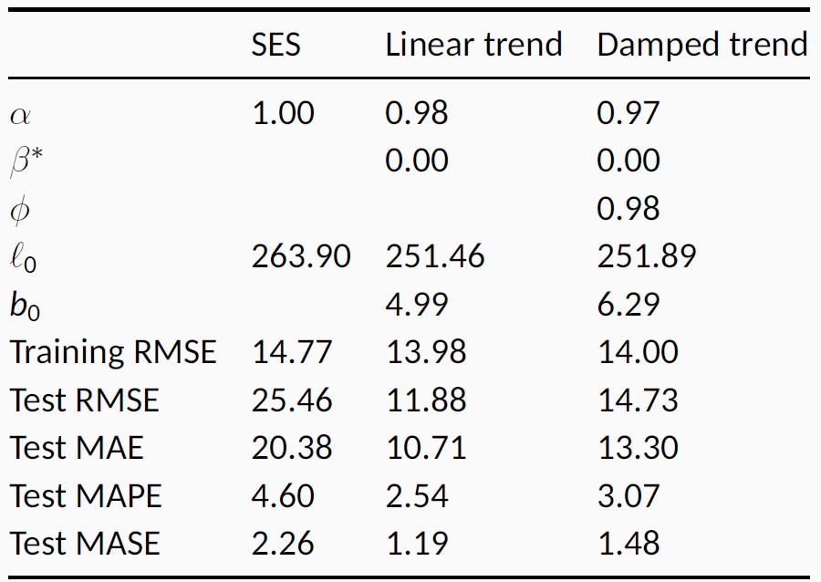
7.2 Trend Methods: Comparison
The following codes use the whole dataset as the testing set, you can also change the testing set. Even when you use the series after 2000 as the testing set, you still get the same conclusion.
Linear trend has the highest forecast accuracy in this case when using this method
Parameters
summary(fit1) summary(fit2) summary(fit3)
Accuracy

Slide 15
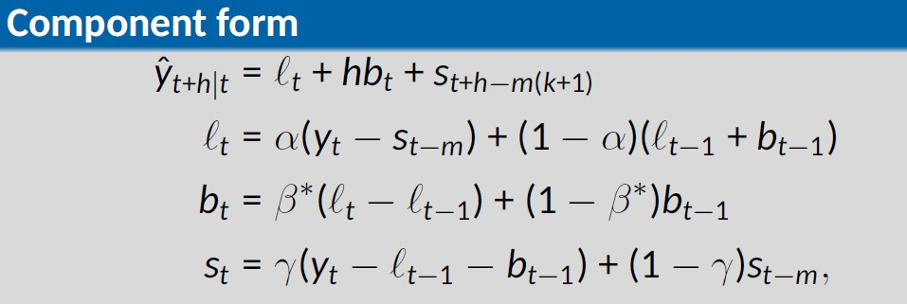
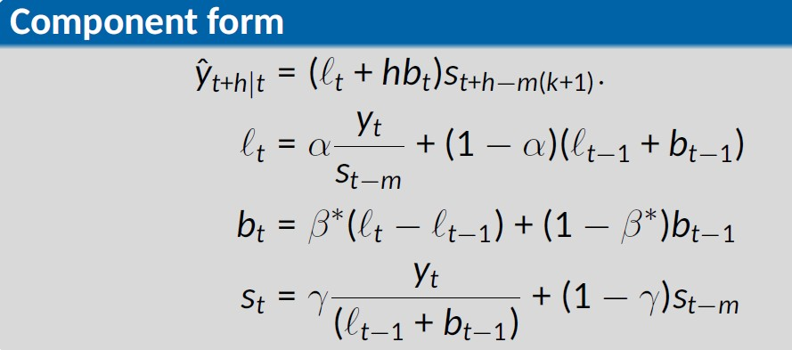

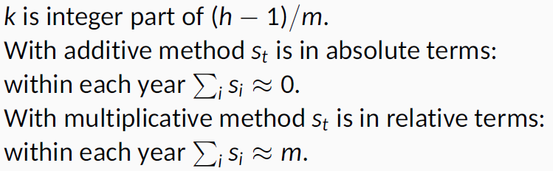
7.3 Holt-Winters’ Seasonal Method
Holt (1957) and Winters (1960) extended Holt’s method to capture seasonality
Comprise the forecast equation and three smoothing equations:
One for the level ℓ_{t}, smoothing parameter α
One for the trend b_{t}, smoothing parameter β*
One for the seasonal component s_{t}, smoothing parameter γ.
for additive method for multiplicative method
Forecast equation
Level equation
Trend component equation Seasonal component equation
1
5

Slide 16
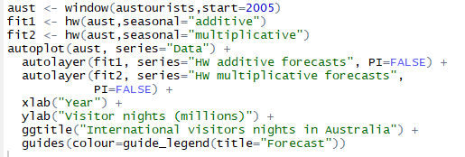

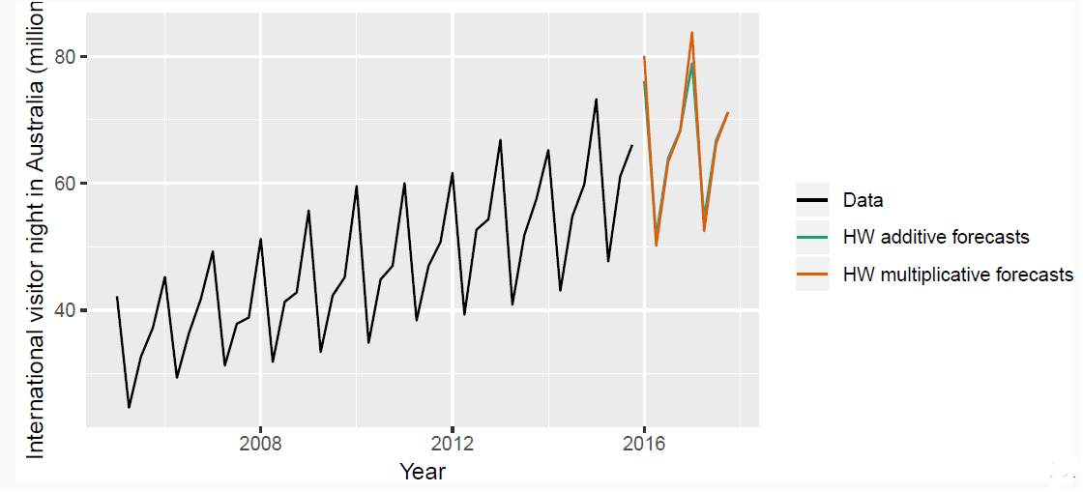
7.3 Holt-Winters’ Seasonal Method: Example
Use hw function to perform Holt-Winters’ Seasonal Method and specify the seasonal argument

Slide 17
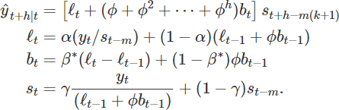
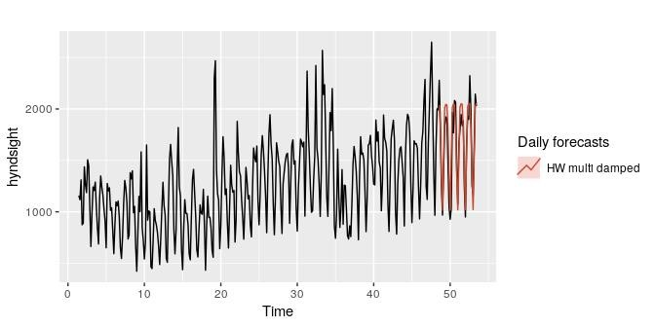
7.3 Holt-Winters’ Seasonal Method: Damped
Damping is possible with both additive and multiplicative Holt-Winters’ methods.
A method that often provides accurate and robust forecasts for seasonal data is the Holt-Winters method with a damped trend and multiplicative seasonality

Slide 18
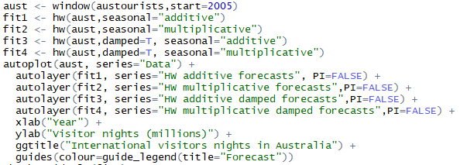
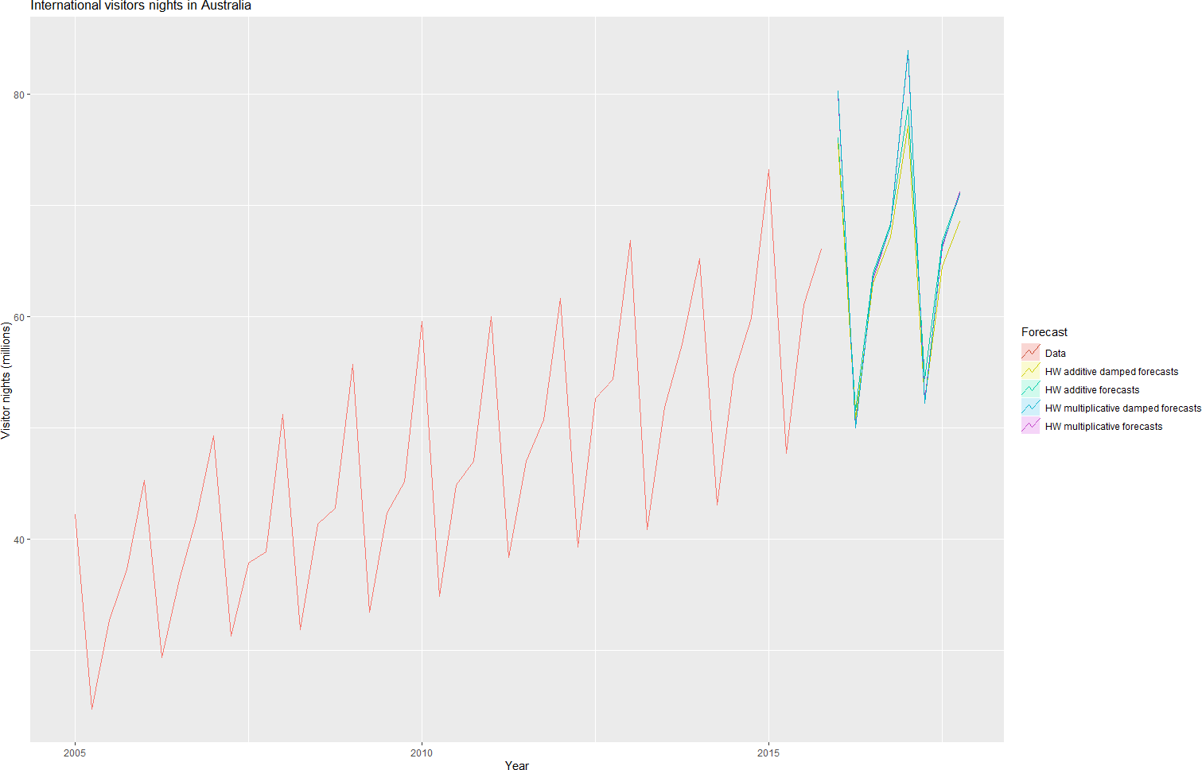
7.3 Holt-Winters’ Seasonal Damped Method: Example
The next slide compares the residuals charts across the four methods. The Holt-Winters method with a damped trend and multiplicative seasonality generates
the best result.
18

Slide 19
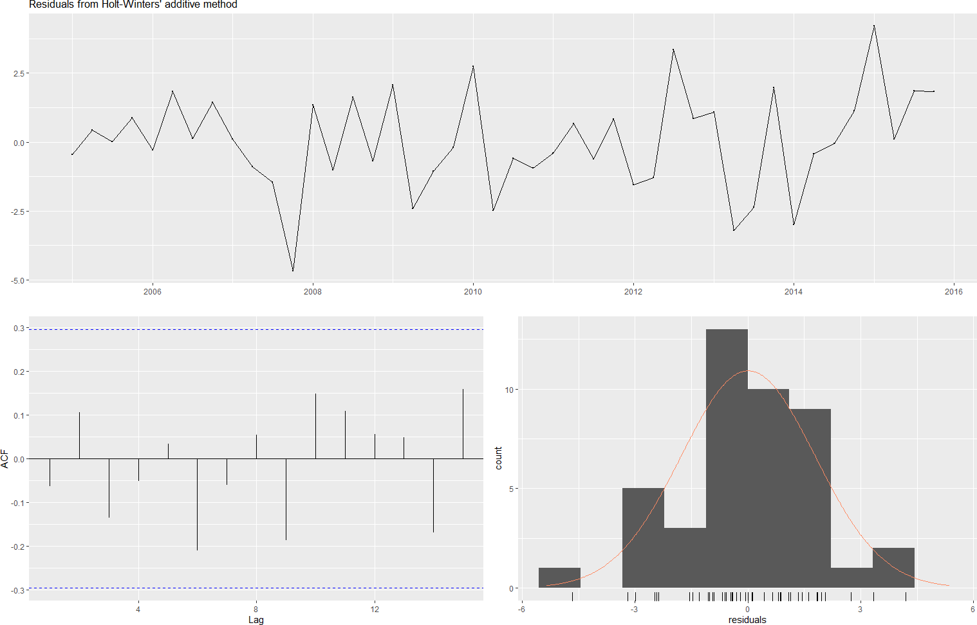
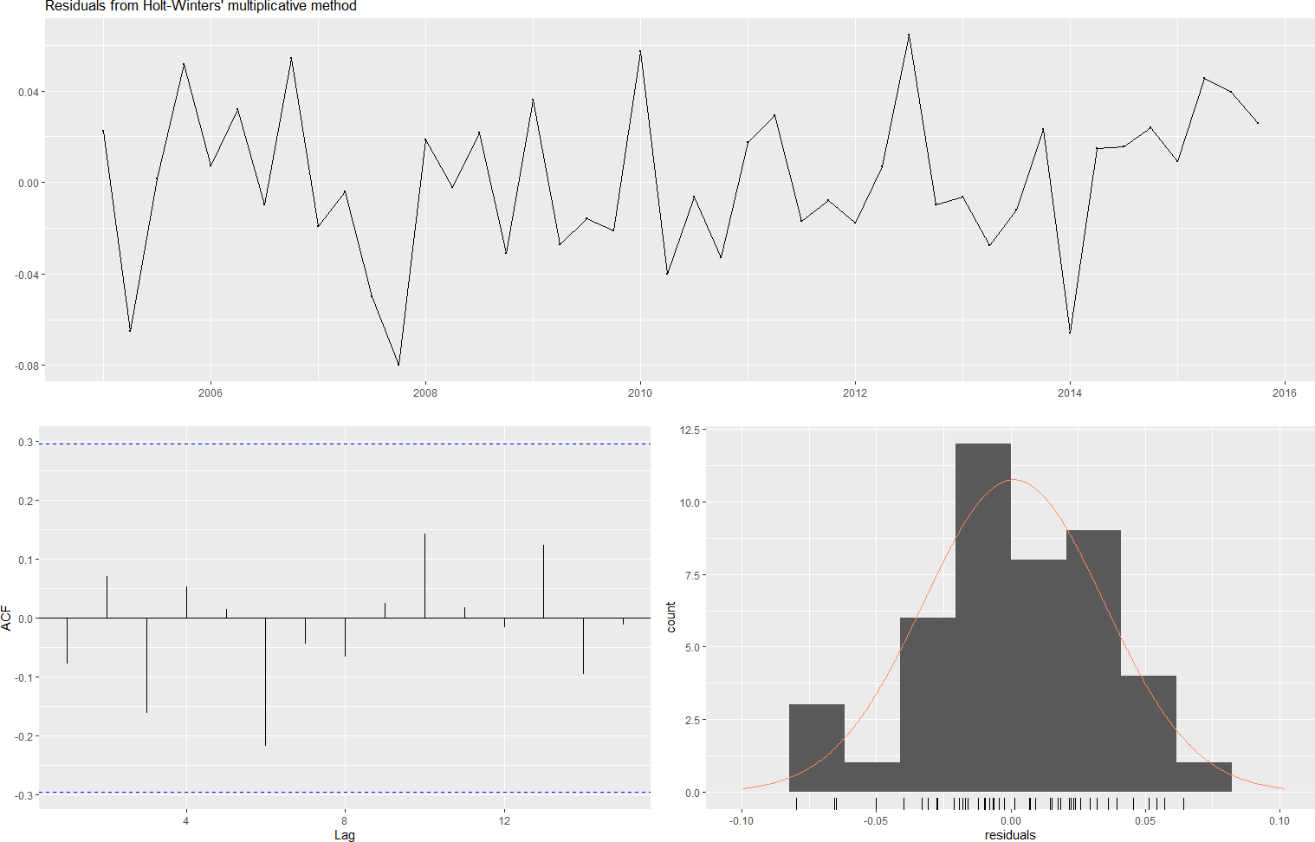
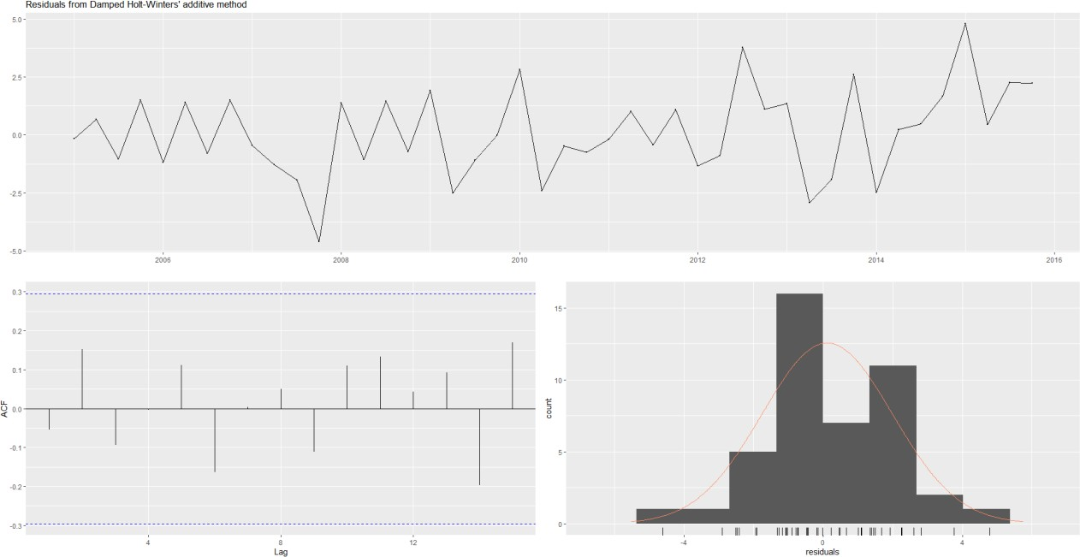
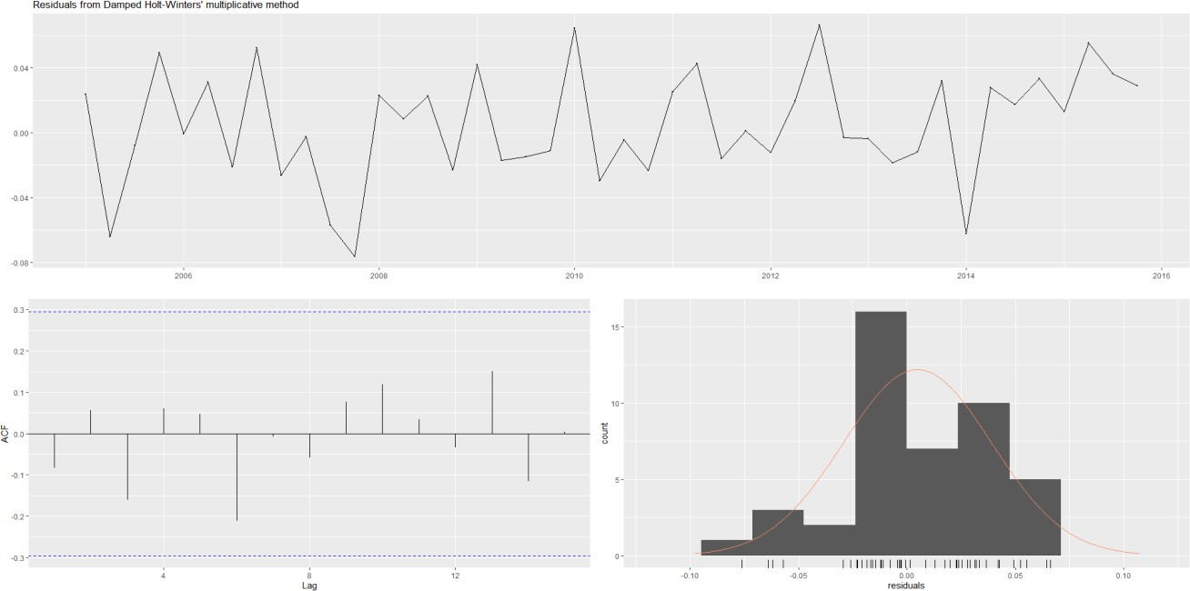
Ljung-Box test p value =0.035
Ljung-Box test p value =0.106
Ljung-Box test p value =0.089
Ljung-Box test p value =0.114
19

Slide 20
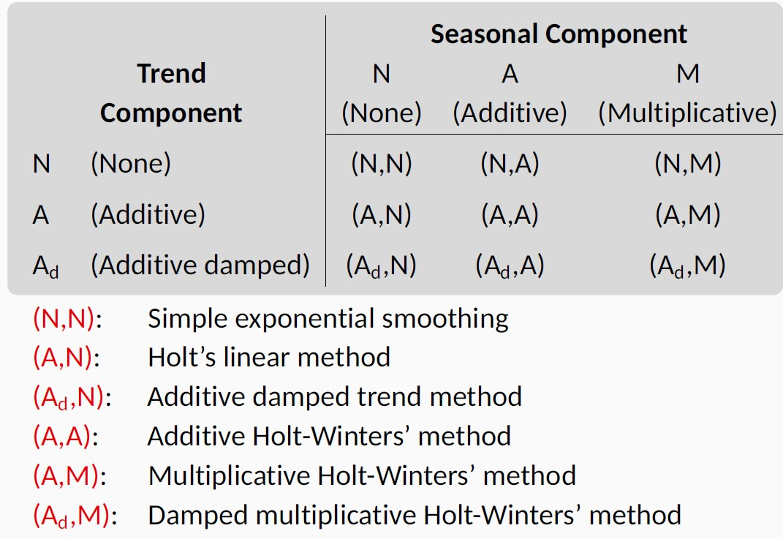
7.4 A Taxonomy of Exponential Smoothing Methods
This Taxonomy was first proposed by Pegels (1969)
Later extended
by Gardner (1985) to include methods with an additive damped trend
Extended by Taylor (2003) to include methods with a multiplicative damped trend.

Slide 21
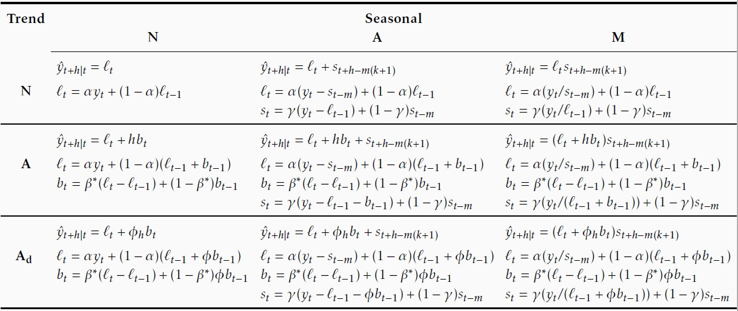
7.4 A Taxonomy of Exponential Smoothing Methods

Slide 22



7.4 A Taxonomy of Exponential Smoothing Methods
Combination of no trend with seasonality not possible using these functions.
→ ses(y)
→ holt(y)
→ holt(y, damped=TRUE)
→ hw(y, damped=FALSE, seasonal="additive")
→ hw(y, damped=FALSE, seasonal="multiplicative")
→ hw(y, damped=TRUE, seasonal="multiplicative")
Damped Additive Holt-Winter’s Method
→ hw(y, damped=TRUE, seasonal="additive")
22

Slide 23
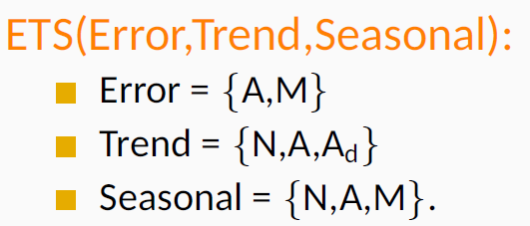
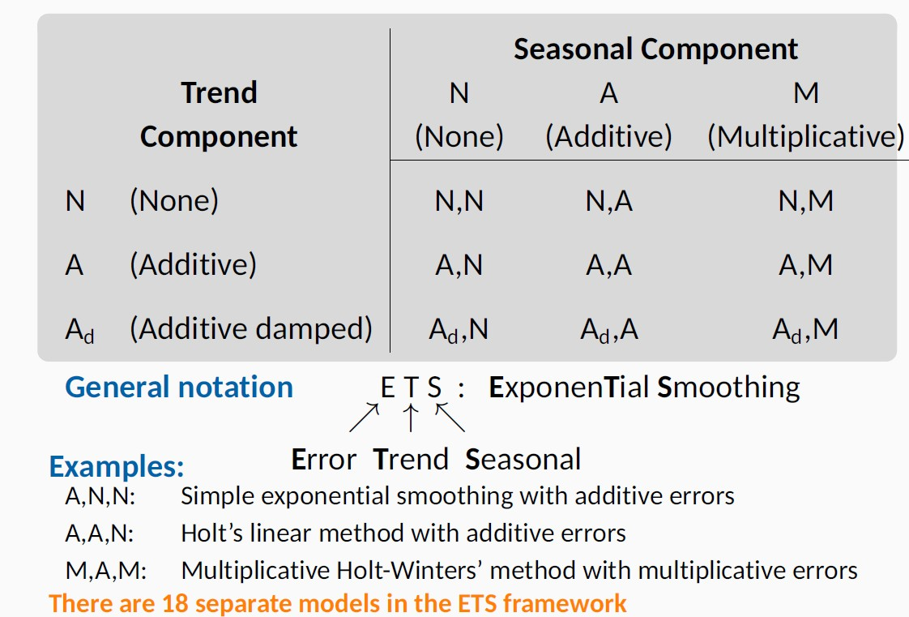
7.5 State Space Models For Exponential Smoothing
Each model has an observation equation and transition equations, one for each state (level, trend, seasonal), i.e., state space models.
Two models for each method: one with additive and one with multiplicative errors. The point forecasts produced by the models are identical if they use the same smoothing parameter values. They will, however, generate different prediction intervals.
In total 18 models (2×3×3).
23

Slide 24
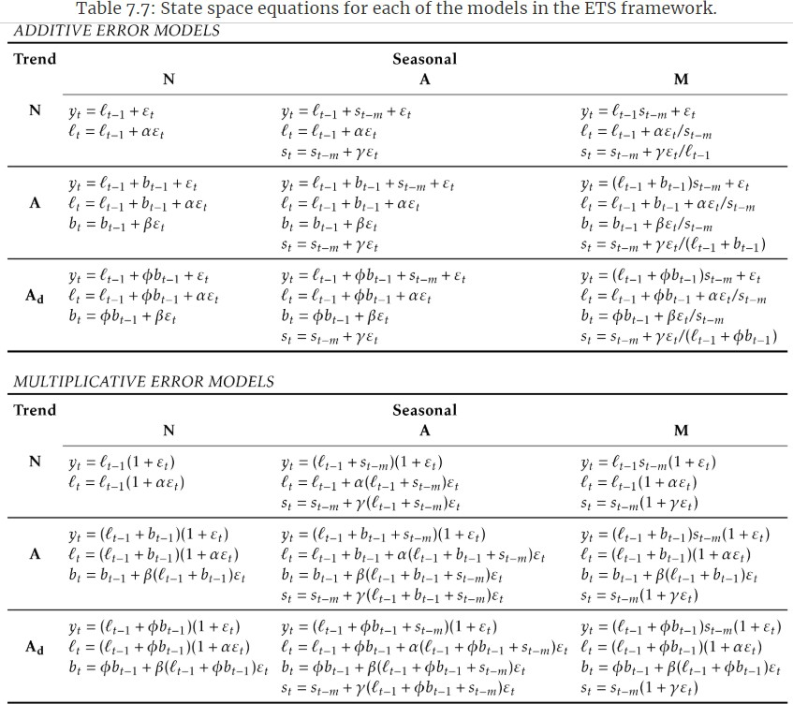
The following shows the difference of error terms in the forecast equation without seasonality, so that you can understand the difference between additive error models and multiplicative error models (no need to memorize these equations).
ε_{t}
vs.
^{ℓ}t−1^{ε}t
ε_{t} vs.
^{(b}t-1^{+ℓ}t−1^{)ε}t
ε_{t} vs.
(ϕb_{t-1}+ℓ_{t−1})ε_{t}
2
4

Slide 25
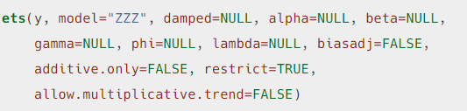
7.6 Estimation and Model Selection
Estimate the parameters by minimizing SSE or maximizing the “likelihood”, which is the probability of the data arising from the specified model.
A large likelihood or a small SSE is associated with a good model.
For models with additive errors, maximizing the likelihood = minimizing SSE → residuals = the one-step training errors
For models with multiplicative errors, maximizing the likelihood ≠ minimizing SSE → residuals ≠ the one-step training errors (See a comparison in Slide 30)
Estimate models with the ets() function in the forecast package
A great advantage of the ETS statistical framework is that information criteria can be used for model selection.
The AIC, AICc and BIC, introduced in Section 5.5, can be used here to determine which of the ETS models is most appropriate for a given time series.
The three key arguments (see the explanation in our textbook for others)
y: The time series to be forecast.
Model: A three-letter code indicating the model to be estimated using the ETS
classification and notation. The possible inputs are “N” for none, “A” for additive,
“M” for multiplicative, or “Z” for automatic selection.
Damped: If damped=TRUE, then a damped trend will be used (either A or M). If damped=FALSE, then a non-damped trend will used. If damped=NULL (the default), then either a damped or a non-damped trend will be selected, depending on which model has the smallest value for the information criterion.

Slide 26
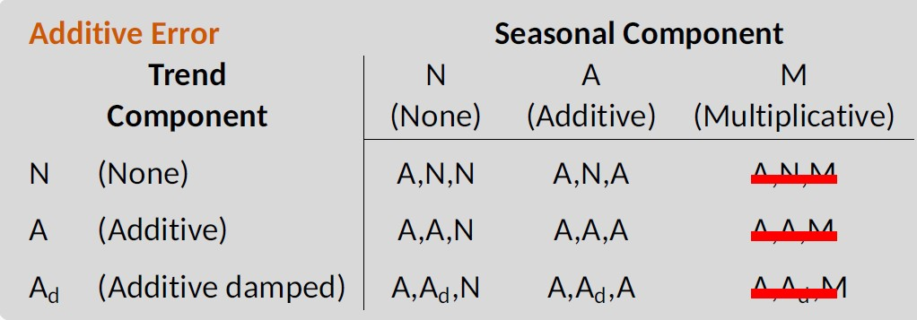
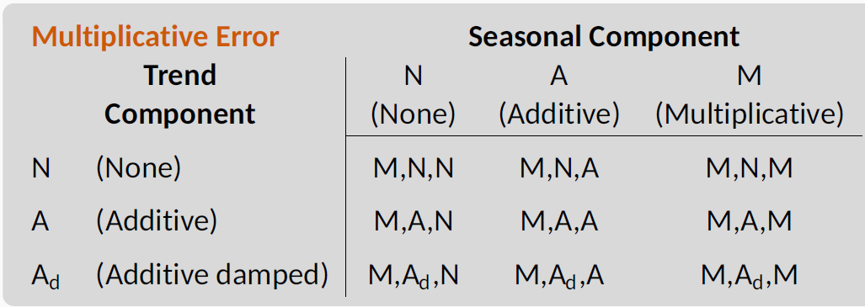
7.6 Estimation and Model Selection
The three models lead to numerical difficulties due to division by values potentially close to zero in the state equations.
We normally do not consider these three
combinations when selecting a model.
All the nine models with multiplicative errors are useful when the data are strictly positive, but are not numerically stable when the data contain zeros or negative values.
The nine models will not be considered if the time series is not strictly positive.

Slide 27
7.6 Model Selection: Working with ets objects
The ets() function will return an object of class ets.
There are many R functions designed to make working with ets objects easy.
Function | Description
coef() | Return all fitted parameters.
accuracy() | Return accuracy measures computed on the training data.
summary() | Print some summary information about the fitted model.
autoplot() or plot() | Produce time plots of the components, even though the plots are slightly different: autoplot() provides the grey bar to the right of each panel, while plot() does not.
residuals() or resid() | Return residuals from the estimated model. The type argument is used in the residuals() function to distinguish between residuals and forecast errors: the default option, type='innovation‘, gives regular residuals, while type = ‘response’ gives the forecast error (the one-step training error).
fitted() | Return one-step forecasts for the training data.
simulate() | Simulate future sample paths from the fitted model. You will get different results each time when you run it
forecast() | Compute point forecasts and prediction intervals, as described in the next section.
27

Slide 28
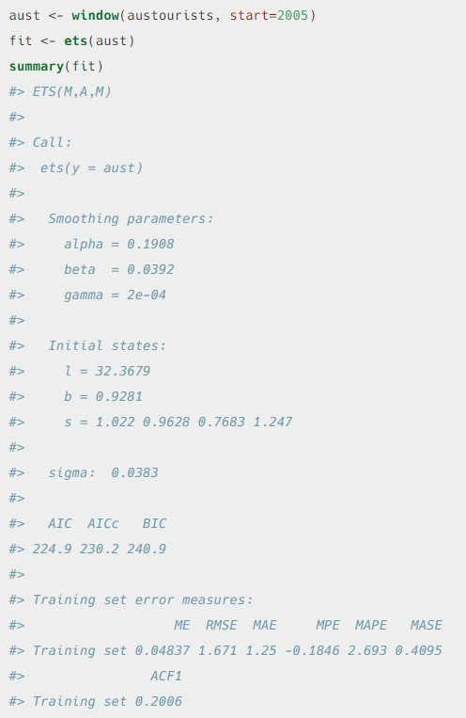
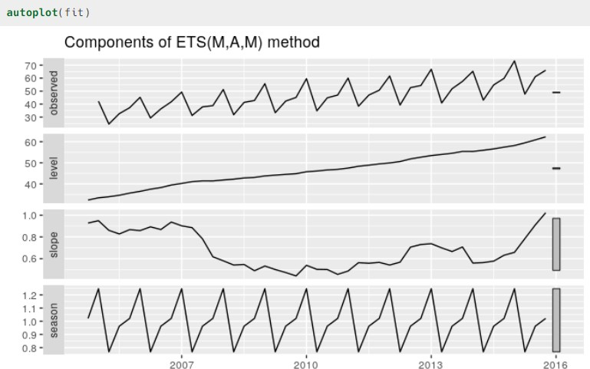
7.6 Model Selection: Examples
Tell you which model is
optimal and selected
Different from decomposition in Chapter 6, the components here represent the actual data (Observed) and the three component equations (level, slope, and seasonality).
Parameters
Predictive Accuracy (see
also in Chapter 5.5)
Forecast errors from the training set (see also in Chapter 3.4)
28

Slide 29
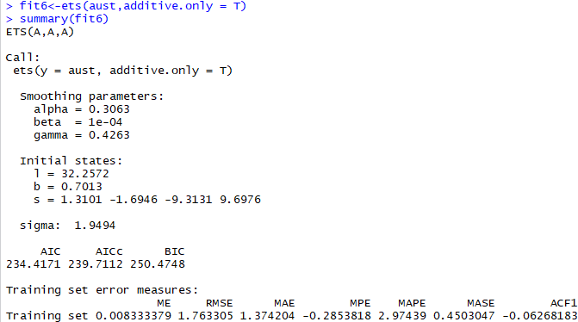
7.6 Model Selection: Examples
Only choose from the models with additive components
ETS(M,A,M) has higher prediction accuracy than ETS(A,A,A), that is why ETS(M,A,M) is selected when we consider all the models.

Slide 30
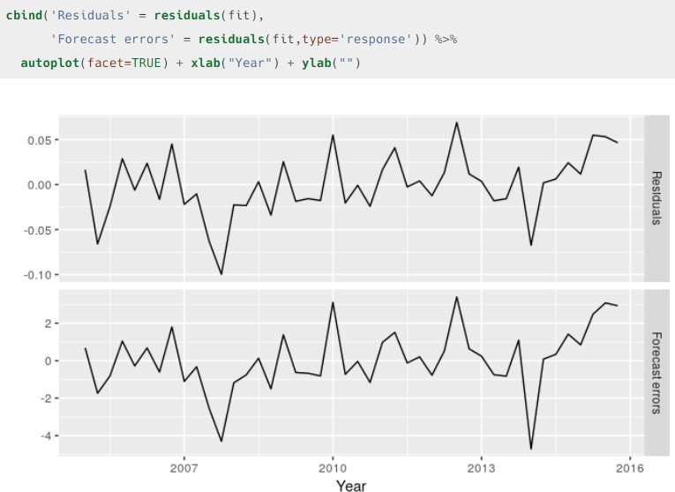
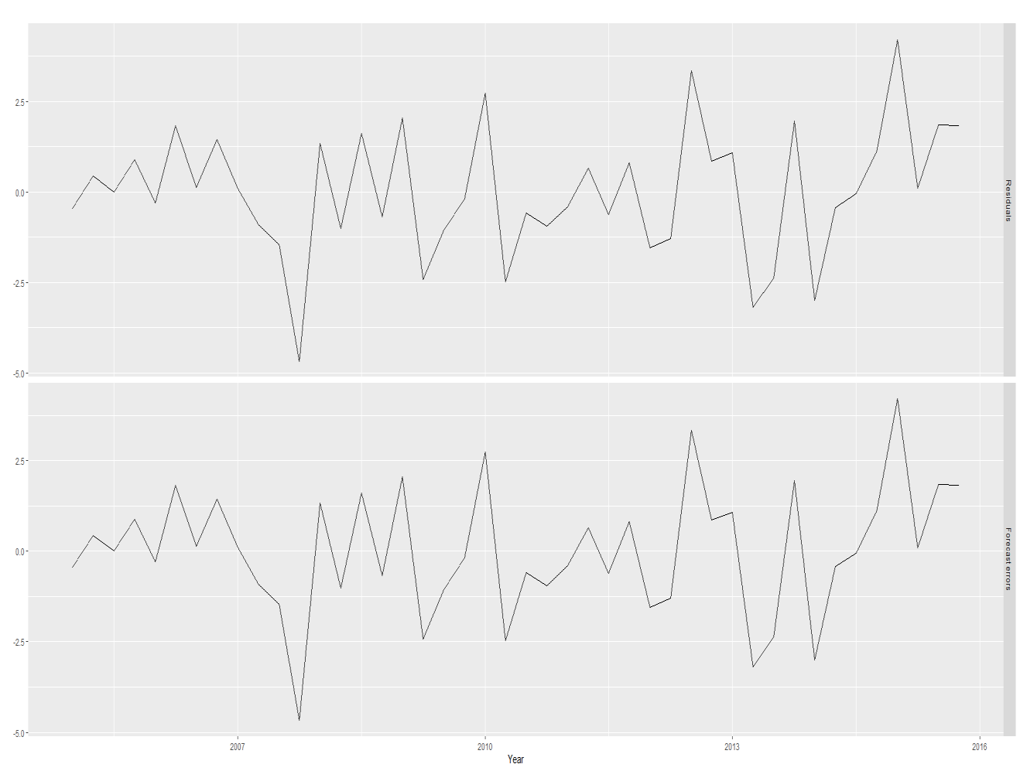
7.6 Model Selection: Examples
ETS(M,A,M) has multiplicative errors, so the residuals ≠ the one-step training errors.
ETS(A,A,A) has additive errors, so the residuals = the one-step training errors.
ETS(M,A,M)
ETS(A,A,A)

Slide 31
7.7 Forecasting with ETS Models
Point forecasts are obtained from the models by iterating the equations for t=T+1,…, T+h and setting all ε_{t}=0 for t>T.
ETS point forecasts are equal to the medians of the forecast distributions.
For models with only additive components, the forecast distributions are normal, so the
medians and means are equal.
For ETS models with multiplicative errors, or with multiplicative seasonality, the point forecasts will not be equal to the means of the forecast distributions.
Prediction intervals can also be generated in ETS models.
The prediction intervals will differ between models with additive and multiplicative methods.
For most ETS models, a prediction interval can be written as

Slide 32

7.7 Forecasting with ETS Models: Using forecast()
Argument | Description
object | The object returned by the ets() function.
h | The forecast horizon — the number of periods to be forecast.
level | The confidence level for the prediction intervals.
fan | If fan=TRUE, level=seq(50,99,by=1). This is suitable for fan plots.
simulate | If simulate=TRUE, prediction intervals are produced by simulation rather than using algebraic formulas. Simulation will also be used (even if simulate=FALSE) where there are no algebraic formulas available for the particular model.
bootstrap | If bootstrap=TRUE and simulate=TRUE, then the simulated prediction intervals use re-sampled errors rather than normally distributed errors.
npaths | The number of sample paths used in computing simulated prediction intervals.
PI | If PI=FALSE or F, then point forecast only is calculated; otherwise the prediction intervals are produced (default)
lambda | The Box-Cox transformation parameter. This is ignored if lambda=NULL. Otherwise, the forecasts are back-transformed via an inverse Box-Cox transformation.
biasadj | If lambda is not NULL, the back-transformed forecasts (and prediction intervals) are bias-adjusted.
32

Slide 33
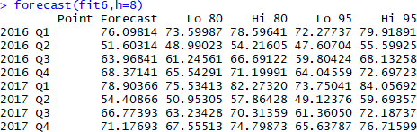
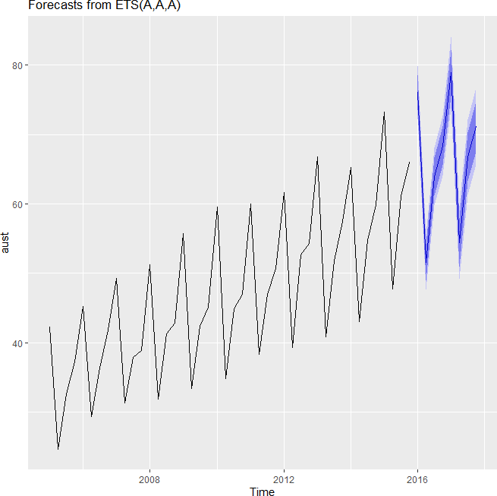
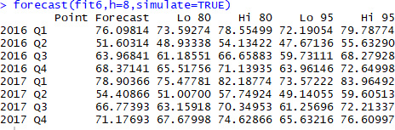
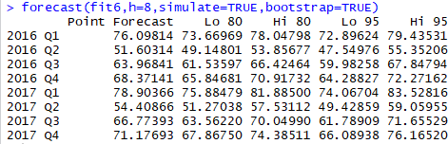
7.7 Forecasting with ETS Models: Examples
See Slide 29 for model fit6
or
When using simulate=TRUE, the point estimates
are still the same, but PIs are slightly different

Slide 34
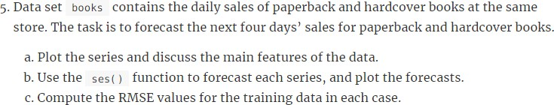
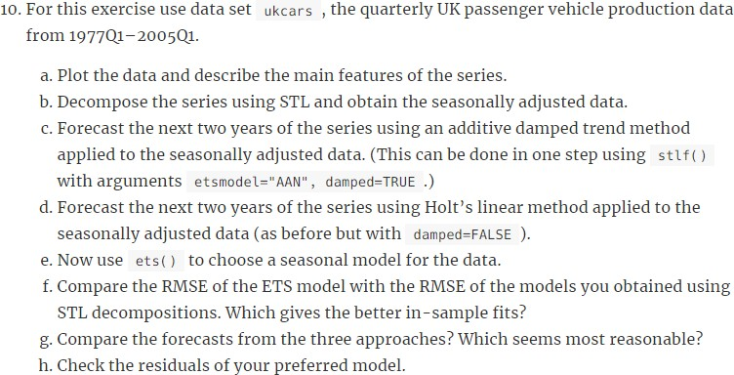
7.8 Exercises (Q5, Q10, and Q14)

